Slide 1


01_W e l c o m e
www.ksmmediahut.com

Slide 2
ksmmediahut
ksmmediahut
Focus Strategies
www.ksmmediahut.com
Focus Strategies
Adwords – Pay Per Click (PPC) Advertisement for Google
FACEBOOK Marketing

Slide 3
ksmmediahut
ksmmediahut
Pay Per Click Advertisement (PPC)
www.ksmmediahut.com
Pay Per Click Advertisement (PPC)
Google Display Network (GDN)
Google Search Network (GSN)

Slide 4

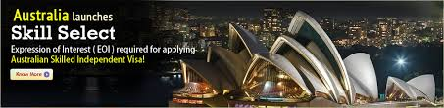
ksmmediahut
ksmmediahut
Google Display Network (GDN)
www.ksmmediahut.com
Google Display Network (GDN)
Text Ads
Image Ads

Slide 5

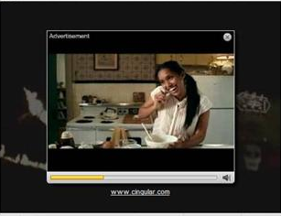
ksmmediahut
ksmmediahut
Google Display Network (GDN)
www.ksmmediahut.com
Google Display Network (GDN)
Rich Media Ads
Video Ads

Slide 6
ksmmediahut
ksmmediahut
Google Display Network (GDN)
www.ksmmediahut.com
Our Strategy for GDN
Image Ads
Best converted sizes
Medium Rectangle (300x250)
Large Rectangle (336x280)
Wide Skyscraper (160x600)
Leader board (728x90)

Slide 7
ksmmediahut
ksmmediahut
Google Display Network (GDN)
www.ksmmediahut.com
Best BID Strategy Practice for GDN
Cost Per Impressions (CPM)
Suitable for increase brand awareness by increasing the reach of ads.
Cost Per Click (CPC)
Suitable if some one want viewers to click on ads.

Slide 8
ksmmediahut
ksmmediahut
Google Display Network (GDN)
www.ksmmediahut.com
Our BID Strategy for GDN
Cost Per Impressions (CPM)
This bid strategy will increase the brand value as our ads will appear to the thousands of viewer.

Slide 9
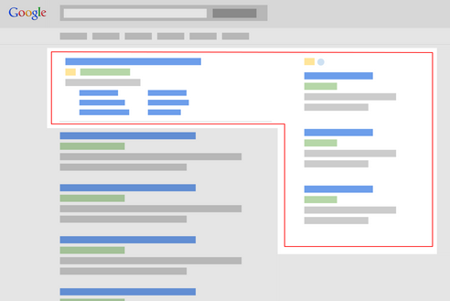
ksmmediahut
ksmmediahut
Google Search Network (GSN)
www.ksmmediahut.com
Google Search Network (GSN)

Slide 10
ksmmediahut
ksmmediahut
Google Search Network (GSN)
www.ksmmediahut.com
Our BID Strategy for GSN
Cost Per Click (CPC)
In search network main focus is to bring the users on website and enforce them to perform a conversion action.

Slide 11
ksmmediahut
ksmmediahut
Google Search Network (GSN)
www.ksmmediahut.com
Top 10 Keywords for Search Ads
australian immigration consultant | australian visa consultants
australian immigration agency | australian visa agent
best australian immigration consultant | study visa autralia
australian immigration agent | china study visa agents
australia immigration consultants | immigration experts au
But there are many more

Slide 12
ksmmediahut
ksmmediahut
FACEBOOK Marketing
www.ksmmediahut.com
FACEBOOK Marketing
Suitable types of FACEBOOK Marketing
Boost your posts
Promote your page
Send people to your website

Slide 13
ksmmediahut
ksmmediahut
Benefits
www.ksmmediahut.com
Benefits of Internet Marketing
24 X 7
Low cost high return
Control your budget
Leave this on us
Control the time you when you want to run your advertisement campaigns
Complete analysis of your customers
Can analyze your customer behavior and revise the strategy
Can push your customer to perform a desire converted action

Slide 14
Budget
Budget
Depends on you, our strategies will vary according to your define budget.

Slide 15
ksmmediahut
ksmmediahut
Internet Marketing
www.ksmmediahut.com
Strategies for Internet Marketing
Leave this on us
Leave this on us ☺

Slide 16

ksmmediahut
ksmmediahut
V I s I t U s
Visit Us
ksmmediahut ksmmediahut
www.ksmmediahut.com

Slide 17
T h a n k y o u
Thank you

